Slide 1
AIRFRAME
PROGRESS REPORT
MARK ODHIAMBO & VIVIAN MWANGI

Slide 2
[Github issue #95]Research on rocket stability tests
This is the test to be done to ensure that the rocket is stable and does not destablize during launch.
So the method found was the swing test.

Slide 3
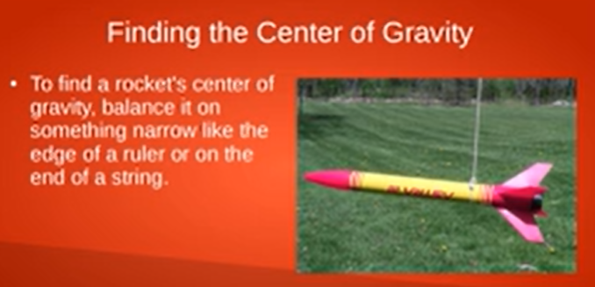

Slide 4
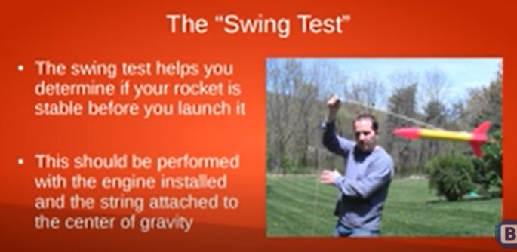

Slide 5
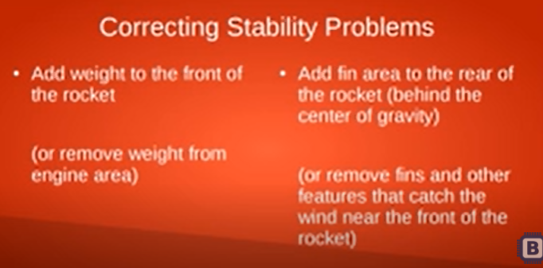

Slide 6
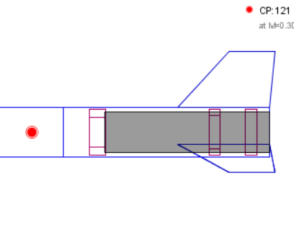
[Github issue#78]Engine block design
This is the block to hold the engine in place

Slide 7
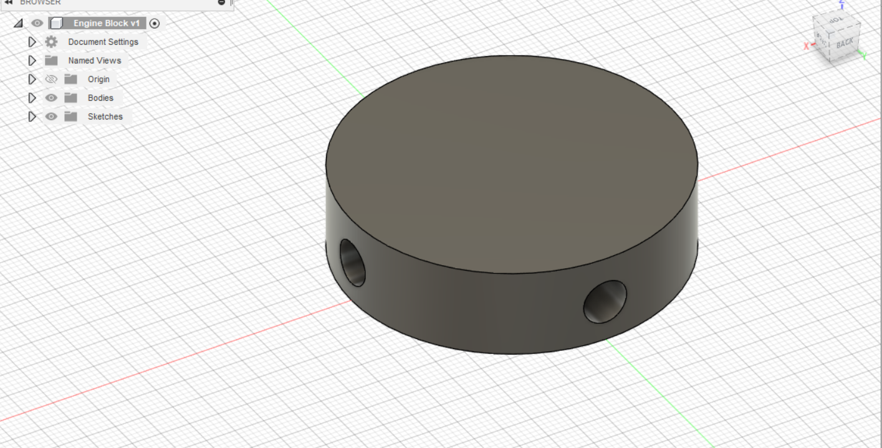
CAD Design

Slide 8
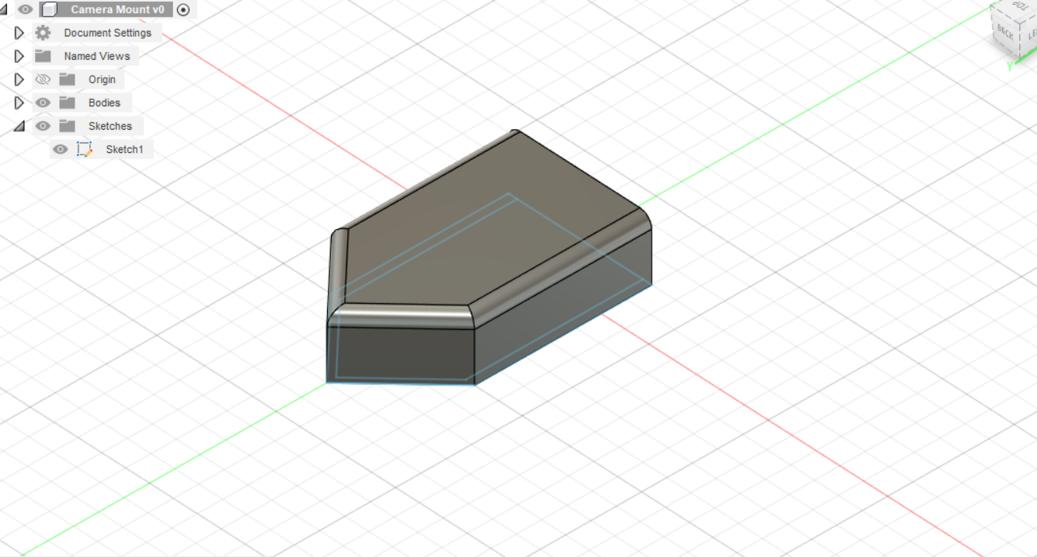
[Github issue#80]Camera mount design
This is the bay which will shield host the camera of the rocket

Slide 9
[Github issue#80] Tee slot design
This is the launch rug or the component that will hold the rocket for its initial launch

Slide 10
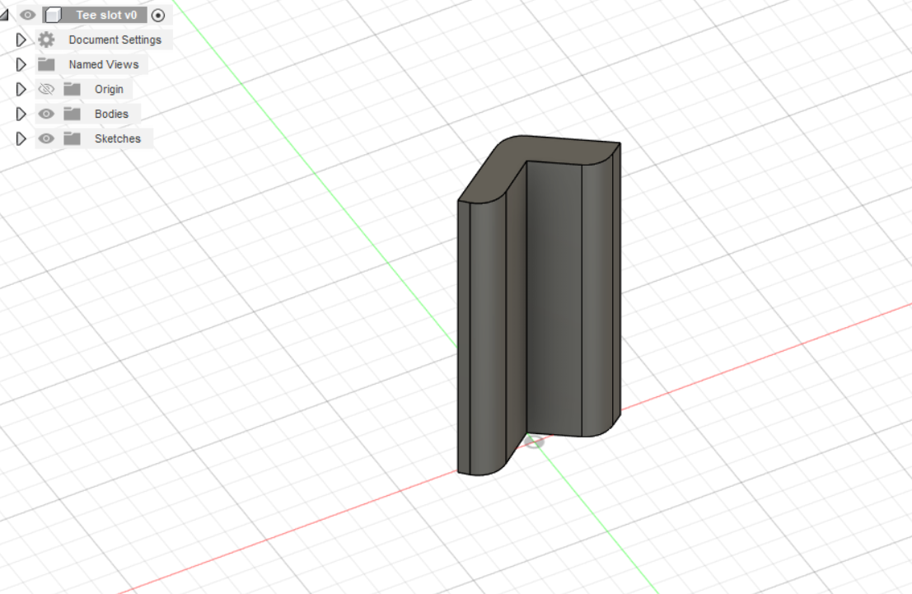

Slide 11
Issues to be done.
Research of fabrication of fins and nose cone[Github issue#94]
Preparation for the third round of fabrication

Slide 12
TIMELINE.
WEEK 1-material SELECTION, ANALYSIS AND COST
WEEK 2-DESIGN AND SIMULATION.
WEEK 3-SIMULATION CORRECTIONS.
WEEK 4-ASSEMBLY AND FABRICATION.
WEEK 5-ASSEMBLY AND FABRICATION.
WEEK 6- RECOVERY SYSTEM
WEEK 7-FINALISATION.
WEEK 8-TAKE OFF.
PRONE TO CHANGE AS PER THE SITUATION.

